Slide 1
Data Types
In C Language

Slide 2
Two Categories of Data
integer data
And real data

Slide 3
Integer Data Types
Signed types | unsigned types
char | unsigned char
short | unsigned short
short int | unsigned short int
int | unsigned int
long | unsigned long
long int | unsigned long int
long long | unsigned long long
long long int | unsigned long long int

Slide 4
Signed Data Ranges
Signed types | Data Range
char | -128 to 127
short | -32768 to 32767
short int | -32768 to 32767
int | -2147483648 to 2147483647
long | -9223372036854775808L to 9223372036854775807L
long int | -9223372036854775808L to 9223372036854775807L
long long | -9223372036854775808L to 9223372036854775807L
long long int | -9223372036854775808L to 9223372036854775807L

Slide 5
Unsigned Data Ranges
unsigned types | Data Range
unsigned char | 0 to 255
unsigned short | 0 to 65535
unsigned short int | 0 to 65535
unsigned int | Zero to 4294967295
unsigned long | Zero to 18446744073709551615
unsigned long int | Zero to 18446744073709551615
unsigned long long | Zero to 18446744073709551615
unsigned long long int | Zero to 18446744073709551615

Slide 6
signed vs unsigned
Signed data types accommodates negative values
Unsigned data types hold only positive values

Slide 7
Size in bytes used to represent
Signed types | unsigned types | Size in bytes
Negative and Positive Values | Only Positive Values
char | unsigned char | 1
short | unsigned short | 2
short int | unsigned short int | 2
int | unsigned int | 4
long | unsigned long | 8
long int | unsigned long int | 8
long long | unsigned long long | 8
long long int | unsigned long long int | 8

Slide 8
Two Categories of Data
integer data
And real data

Slide 9
Real Data Type Sizes
Real | Size in Bytes
float | 4
double | 8
Long double | 16

Slide 10
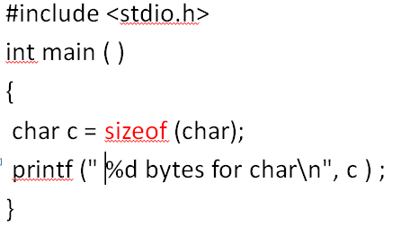
How do we find that size of each data type ?
sizeof ( ) is an operator that computes the size of a data type for us
In our case it is char, which should be 1.

Slide 11
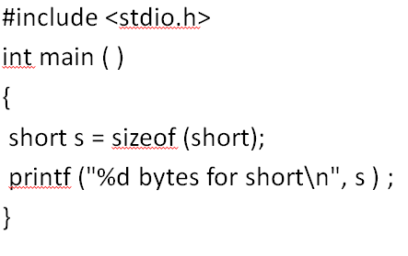
C Program
In this case, it computes for short.
This time, it would print 2.

Slide 12
Pop Quiz - C Program
#include <stdio.h>
int main ( )
{
_____ num = sizeof (____ );
printf (" %d bytes for short \n",
num ) ;
}
Write the C program for data types.

